Slide 1
Patient First Safety
Online Check-In Systems
Armani Wooden & Asher Tadikonda

Slide 2
Agenda
Introduction + Background
Problem Overview
Key Features
Network Components
Network Design
Network Security + Policies
Active Directory + Cloud Systems

Slide 3
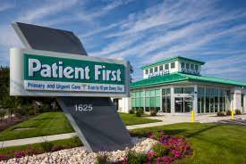
Introduction + Background
Patient First, founded in 1981 by a physician
77 locations across Virginia, Maryland, Pennsylvania, and New Jersey
About 30 employees, works each site
Open everyday of the year, including holidays,
from 8 a.m. to 8
Specializing in urgent and primary care
Major stakeholders patients seeking medical care

Slide 4
Problem Overview
The recommended online check-in system provides a comprehensive solution to increase patient safety, reduce viral transmission risk, and improve healthcare facility operations, particularly during public health emergencies.

Slide 5
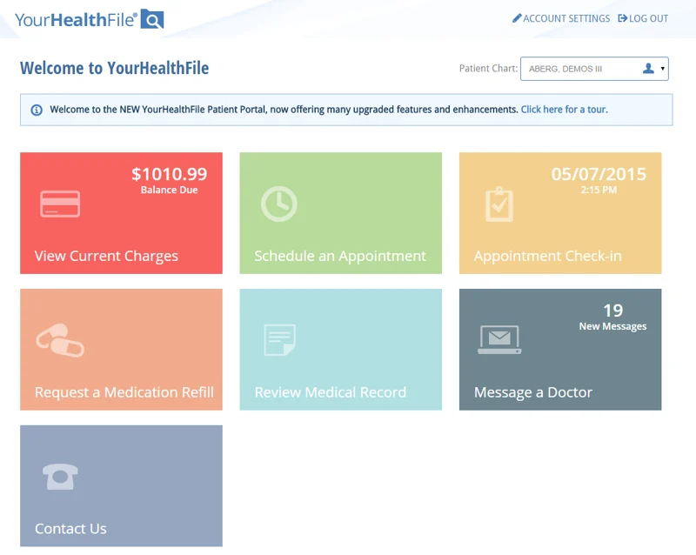
Key Features
- Present the four key features of the proposed online check-in system
- Pre-Appointment Screening
- Virtual Waiting Room
- Text Alerts
- Real-Time Updates on Digital Health Records

Slide 6
Network Components
Integration of telemedicine:
To reduce in-person contact and improve patient safety, particularly during health crises like COVID-19. Telehealth technology enables remote patient consultations and virtual check-ins.
Data analytics and AI:
Utilize tools for machine learning (AI) and data analytics to keep track of patient data, analyze patient flow, and plan out appointments to ensure effective resource management and patient care.
IoT Devices and Sensors:
This will allow healthcare providers to remotely monitor patients' vital signs and symptoms.
cellular applications
Extraordinary Security Measures:
Enhance security in the increasingly digital healthcare environment by employing tools like two-step identification and help strengthen patient data security and protect against online dangers in the rapidly changing world of digital healthcare.
Notes:
The significance of configuring hardware devices, database management, and network topologies. Emphasize the need for high-speed internet connectivity. Examples of needed components are Electronic Health Records (EHR), Telehealth Infrastructure, and Patient Feedback Systems to name a few.

Slide 7
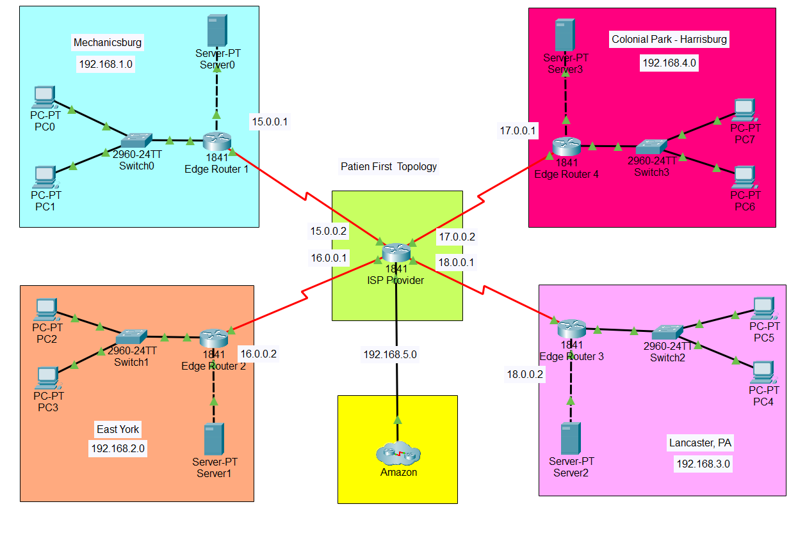
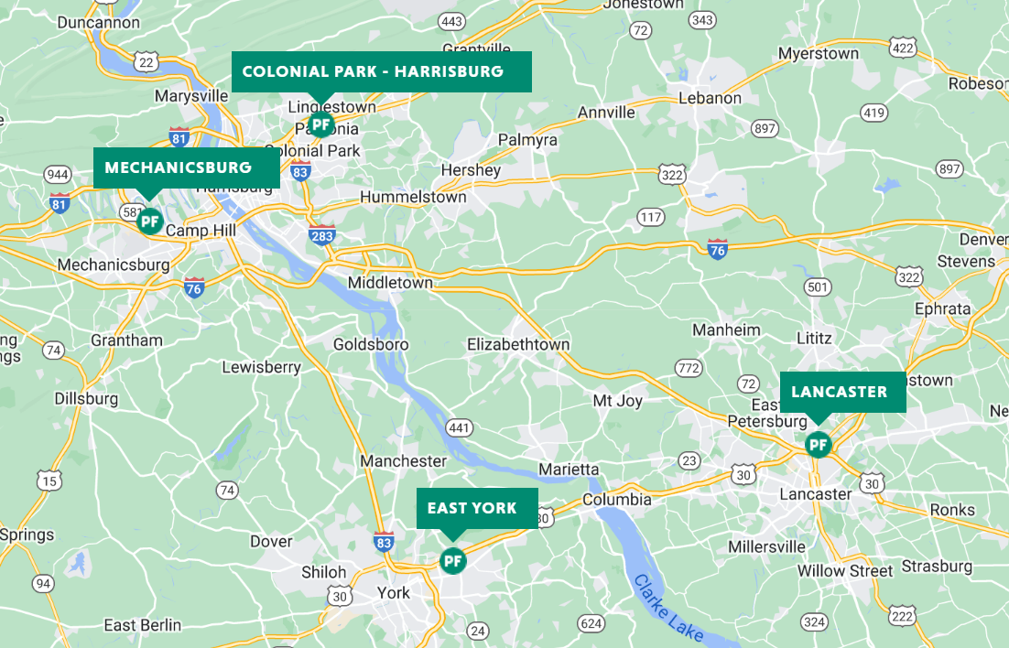
Networking Concepts

Slide 8
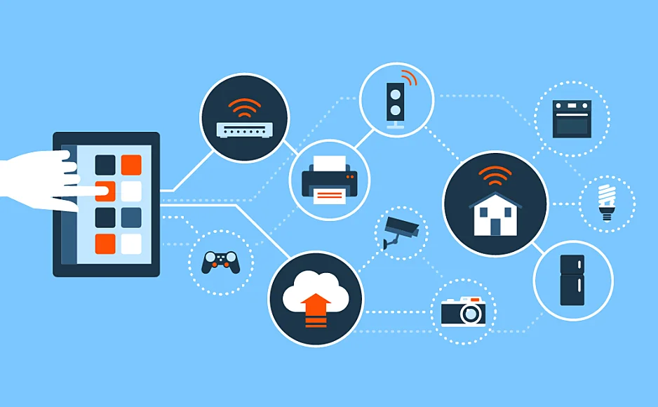
Network Security + Policies
Network security, encryption, and wireless access are critical components of patient safety and confidentiality in healthcare facilities such as Patient First. To ensure that the online check-in system is secure and complies with healthcare regulations, several security measures must be implemented.

Slide 9

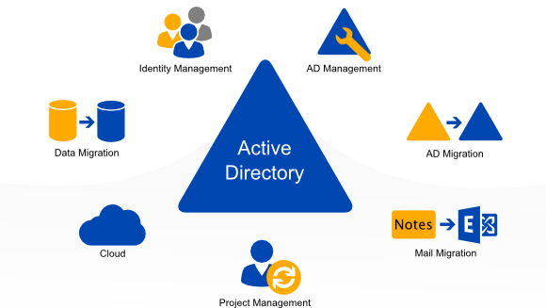
Active Directory + Cloud Systems
Active Directory and cloud systems are important components of modern healthcare facilities such as Patient First. By implementing these technologies, Patient First can streamline operations, improve collaboration, and enhance patient safety and confidentiality.

Slide 10
Q & A

Slide 11
Thank You
THE END

